Slide 1
Research Project Workshop 04:
Efficient Searches, Part I
April 26, 2017
Instructor(s): Andrew Hamilton, MS, MLS & Letisha Wyatt, PhD

Slide 2
learning outcomes
1 How to frame your question (define concept
and keywords)
2 Understand the benefit and application of
controlled vocabulary and indexing
3 Execute and save search results or search
strategy

Slide 3
searching is an art!
Notes:
we want to be comprehensive AND efficient! A method exists!

Slide 4
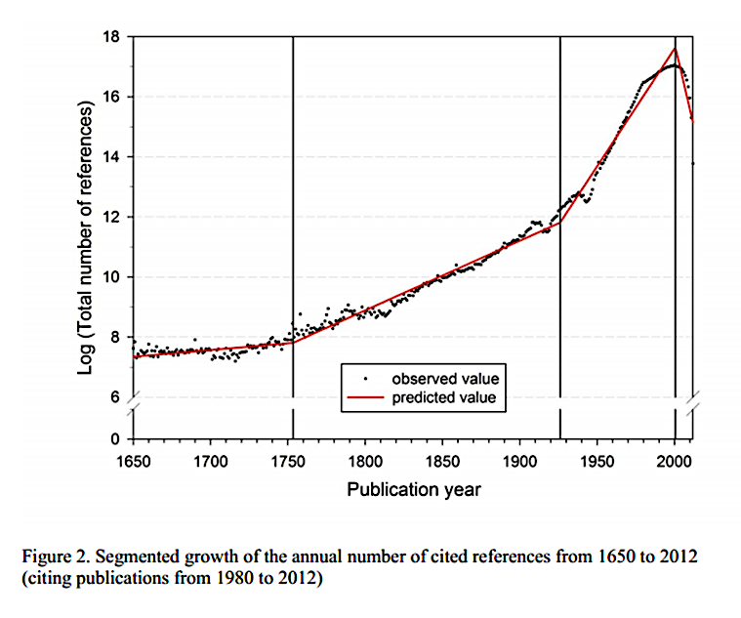
efficiency is key
Log (Total Number of References)
Publication Year
Segmented growth of the annual number of cited references 1650 - 2012
GOA paper: https://arxiv.org/abs/1402.4578
Notes:
Here’s why!
How scholarship is being created and shared, when and where is is discussed, and how it is endorsed is evolving. A 2014 bibliometric analysis estimated that the global scientific output has been increasing at a rate of 8%-9% since the end of World War II. That’s a doubling every nine years! This study was especially interesting in that it analyzed citations to not just scientific articles, but also outputs such as data sets, books, and websites (Nature News Blog: http://blogs.nature.com/news/2014/05/global-scientific-output-doubles-every-nine-years.html).
We could spend a lot of time discussing the reasons for and knowledge impact of this growth, but an important takeaway for discussion is acknowledging the massive amount of content at hand and the challenges that poses in regards to getting your work noticed.
GOA paper: https://arxiv.org/abs/1402.4578

Slide 5


comprehensive searches
specificity
sensitivity
Notes:
WHEN AM I DONE??
we want comprehension but not at the sake of thousands of articles to search through

Slide 6
5 A’s method of searching
Assess
Apply
Ask
Appraise
Acquire
Copyright © Centre for Health Evidence

Slide 7
asking your question
Have you formulated a research question?
Is it “answerable”?
Notes:
We’ll talk about HOW to formulate your question
What makes a question answerable vs. not

Slide 8
refining your question
Concept mapping
PICO
These help:
Define broad topical concepts
Describe relationships between concepts
Organize ideas
Develop keywords
Notes:
Difference between background and foreground question
Concept maps = good for developing background (more mechanistic) questions
PICO = good for developing more clinical (applied) questions **don’t start with a question and pull out pieces for PICO!

Slide 9
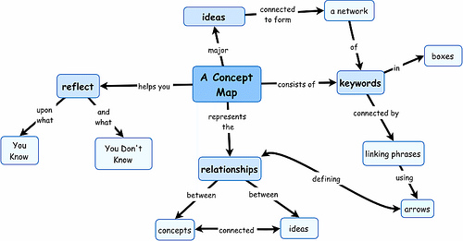
overview of concept maps
Image from here
Notes:
Try making a concept map!
Letisha’s demo
valentine’s day candy example

Slide 10
overview of PICO
P = Population or patient
I = Intervention or exposure
C = Comparison*
O = Outcome
T = Time factors*
S = Setting*
*may not always have this piece

Slide 11
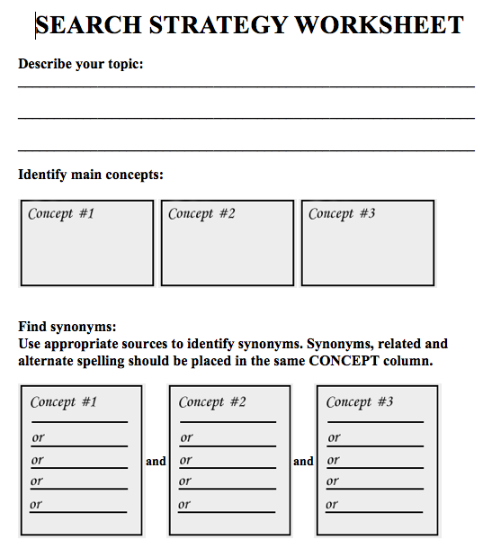
your turn…
Notes:
Sentence breakdown example
Use search strategy worksheet (one side)

Slide 12
PubMed MeSH terms
Medical Subject Headings:
terms tagged to an article when being indexing in PubMed
Controlled vocabulary!
Updated annually
MeSH terms database – essentially a thesaurus
Tree structure
Hierarchies and exploding
Subheadings

Slide 13
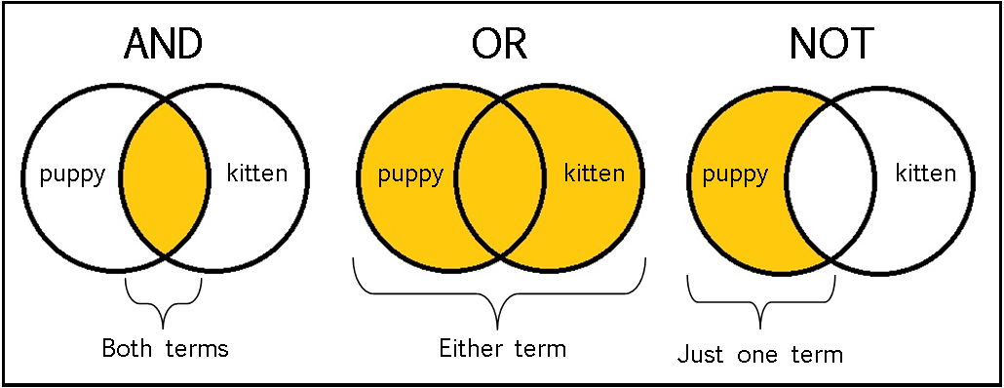
boolean operators
Adapted from https://sites.google.com/a/onalaskaschools.com/tech/boolean-search-tools
Notes:
Provided example: HIV and AIDS; HIV or AIDS

Slide 14
next steps
Building a search (keywords vs. MeSH)
Evaluate your results!
Search details box
MeSH terms on good articles
Revise as needed and try again
Saving your fish: references doc for citation management software
Saving your net: PubMed MyNCBI to save and automate search
Notes:
Build = one term at a time

Slide 15

let’s practice together
OHSU Library Webpage
Notes:
Provided example: car accidents and text messaging
Then they use their research question (goal is to acquire some articles or citation files -> we’ll add to citation manager at upcoming session)

Slide 16
recap
1 How to frame your question (define concept
and keywords)
2 Understand the benefit and application of
controlled vocabulary and indexing
3 Execute and save search results or search
strategy

Slide 17
key resources
PubMed Tutorials
Branching Out: The MeSH Vocabulary (11 min video)
Contact us

Slide 18
questions?
Andrew Hamilton, MS, MLS
hamiltoa@ohsu.edu
503.494.7527
Letisha R. Wyatt, PhD
wyattl@ohsu.edu
503.494.8627

